Slide 1
Event-Driven Programming
Lecturer: Ngo Huy Bien
Software Engineering Department
University of Science
Ho Chi Minh City, Vietnam
nhbien@fit.hcmus.edu.vn

Slide 2

Objectives
To present what is a type.

Slide 3

References
S. Hansen and T.V. Fossum. Event Based Programming. 2010.

Slide 4


What are Events? [1]
An event is an observable occurrence.
An “occurrence" is something that happens at some point in time.
An occurrence is “observable" if it is possible for an observer to notice that it happened.
When an observer responds to an event, we say that the observer handles the event and that the observer is the event handler.
The agent causing the event is the event source and that the agent fires the event.

Slide 5

Event Based Systems
An event based system is a system in which interactions among the agents in the system are governed by events, principally those interactions that are request-response, message-passing, or publish-subscribe.
A system's state is a complete description of the system at some point in time.
As the agents in the system carry out their defined activities and interact with other agents through events, the state of the system changes.

Slide 6
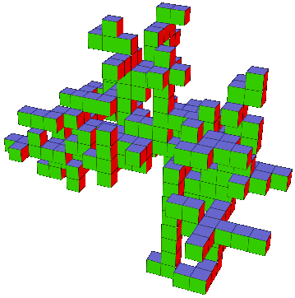
Discrete Systems
A system is said to be discrete if every possible state of the system can be described using a finite amount of memory (a finite number of bits) and if, over any finite time interval, the state of the system changes a finite number of times.
A discrete event system is a discrete system that is event based.

Slide 7
Attributes of Event Based Systems
Event based systems are state based.
The system stays in a stable state until an event occurs.
Event based systems contain varying degrees of non-determinism.
Non-determinism means that it is impossible to determine exactly how a computation will proceed.
Event based systems are built from diverse, loosely coupled components.
The components communicate with each other via events.
Event based systems use decentralized control.
The system starts up and waits for events to occur.

Slide 8
The Event Based Programming Paradigm
Event based programming is paradigm.
It is a way of thinking about problems and their solutions.
It provides abstractions.
The event model is its primary abstraction.

Slide 9
The Event Model
Three types of computational objects are associated with each event, the event source, the event object, and one or more event handlers.
The event source is the originator of the event. Event sources can be any object, hardware, software or firmware.
An event object encapsulates the critical data associated with the event.
Event handlers respond to events by carrying out the actions specified by the programmer.
Event based programs are generally a blend of more traditional code, either procedural or object-oriented, and event code.
Methods and data structures in the traditional code will be accessed from the handlers.

Slide 10


Slide 11

Thank You & See You Again

